Slide 1
Distribution of Hospitals in Toronto
Capstone Final Project

Slide 2
Problem Definition
Toronto is home to many Hospitals but most of the hospitals are present in only certain neighbourhood of Toronto. So, we will try to find out the number of hospitals in different neighbourhoods so that people will take new houses in that neighbourhood.
Using the Foursquare location data, I will determine which neighbourhoods of Toronto are without college or university campuses.

Slide 3
Methodology
A list of Hospitals in Toronto, On was pulled using the Foursquare location data. That list was then cross-referenced with the Wikipedia neighbourhood data to determine what neighbourhood each location was part of by matching the first three digits of the Postal Codes.
This new dataframe was then grouped to determine which neighbourhoods in Toronto contained more number of hospitals. That list was then compared to the total list of neighbourhoods to determine finally what neighbourhoods are hospitals.
Finally, the list of neighbourhoods with institutions was mapped to visually demonstrate whether Toronto higher education institutions are, in fact, equally distributed.

Slide 4
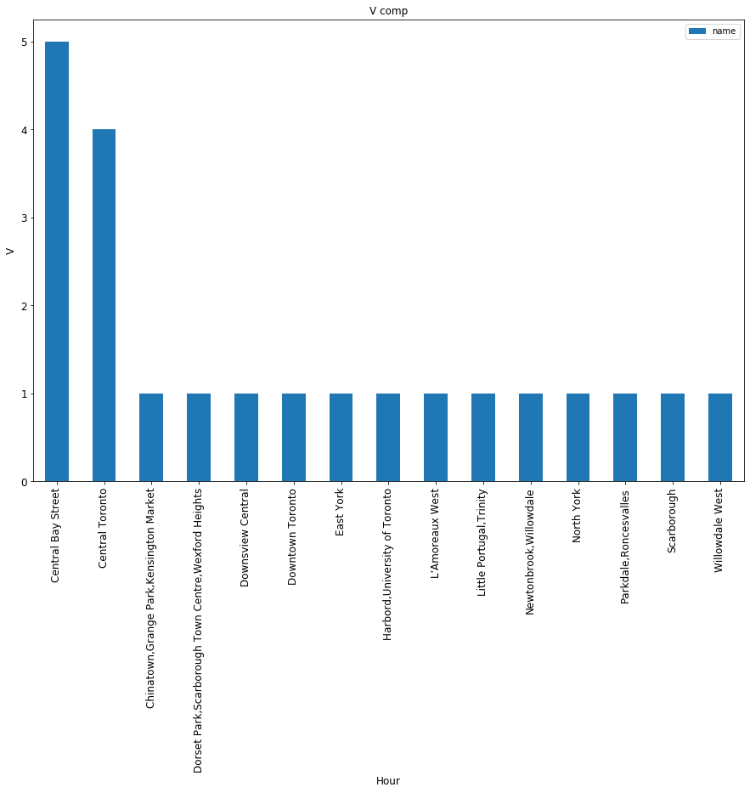
Distribution Graph

Slide 5
Neighbourhoods with High number of hospitals
Central Bay Street
Central Toronto

Slide 6
Conclusion
Analysis shows that while there are more number of hospital inside of the downtown core, there is a cluster in the centre of the city. The majority of Toronto’s neighbourhoods lack Hospitals options. And while the map makes it clear the Toronto’s surrounding area is well represented west of the 401, the areas between the city and the suburbs is almost entirely without options.

